Slide 1
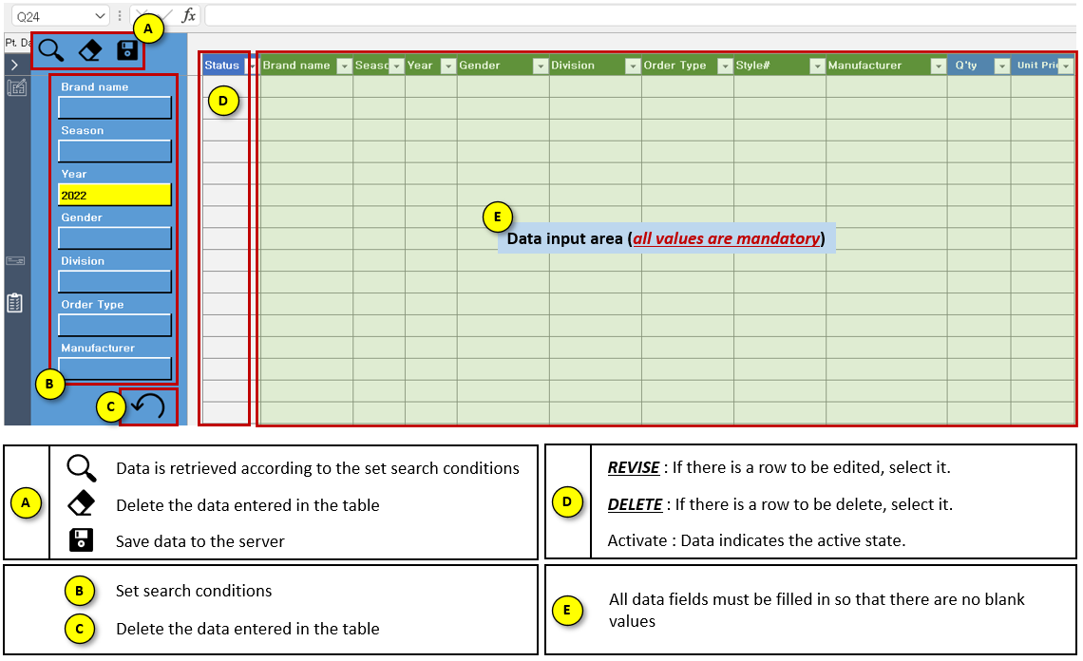
Basic

Slide 2
Search
1. Choose data that you want to filter (example is year 2022),
2. Click search button.

Slide 3
Add Data
1. Go to the most recent data (CTRL+Bottom Arrow Button),
2. Add the data that you want,
3. Click save button.

Slide 4
Revise
1. Go to the data that you want to revise,
2. On “Status” column, there’s a drop down button written “Activate”. Click the drop down and change it to “Revise”,
3. Edit the data that you want to revise,
4. Click save button.

Slide 5
Delete
Go to the data that you want to delete,
Click the drop down button and change the text from “Updated” or “Activate” to “Delete”,
Click the save button.

